Slide 1
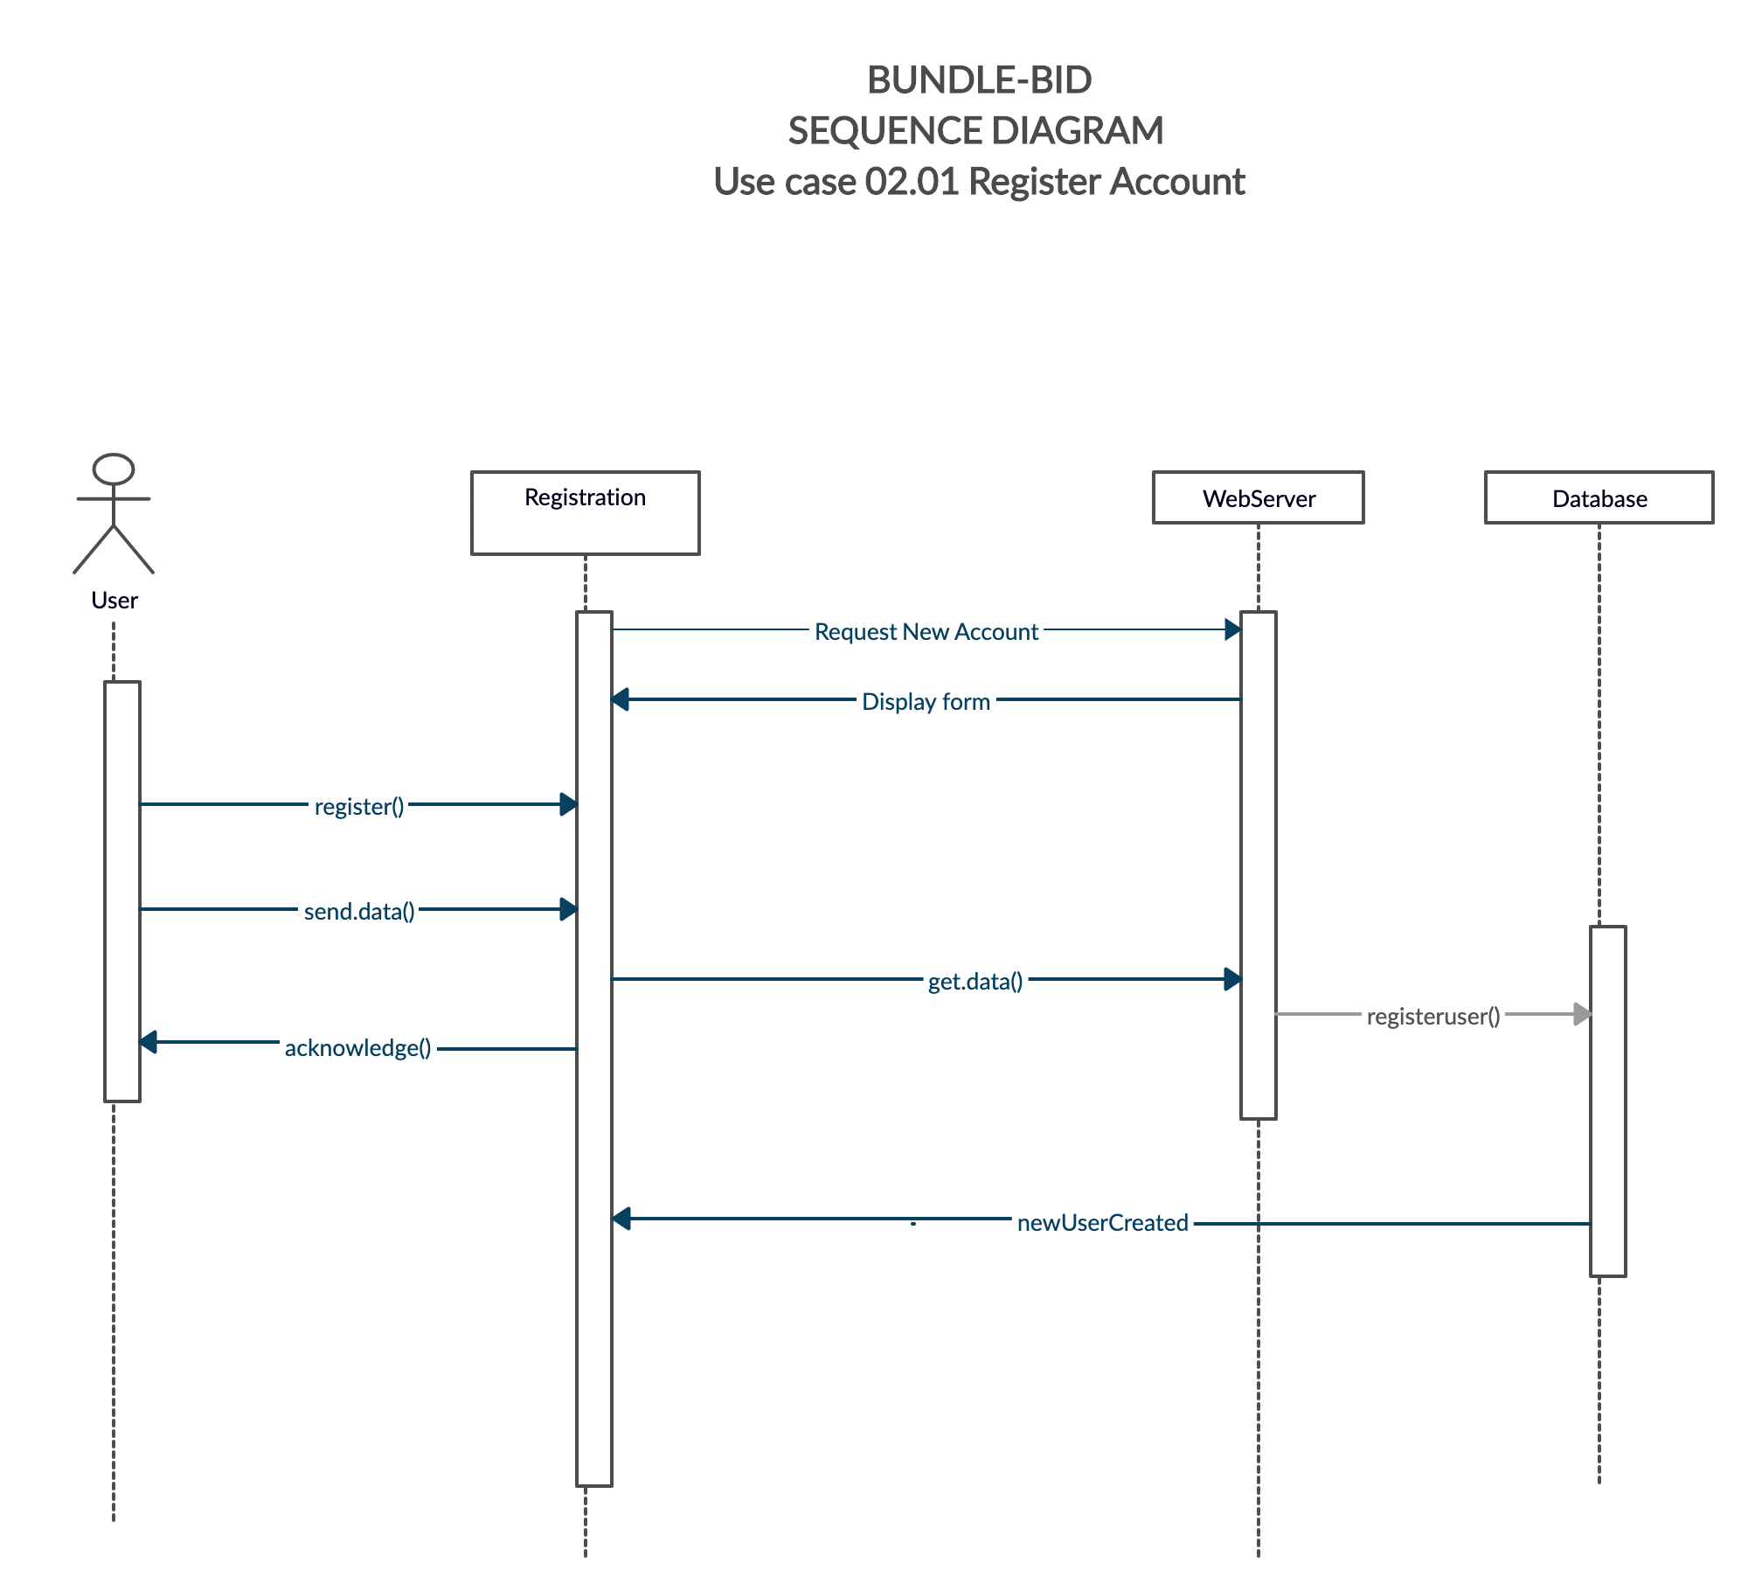
Bundle-Bid Sequence Diagram
Use case 02.01 Register Account

Slide 2
Bundle-Bid Sequence Diagram
Use Case 02.02 Update Account

Slide 3
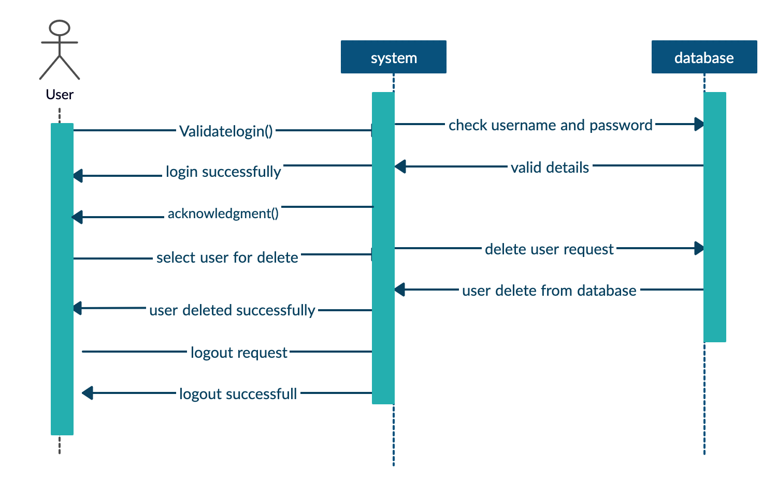
Bundle-Bid Sequence Diagram
02.03 Use Case Diagram Close Account

Slide 4
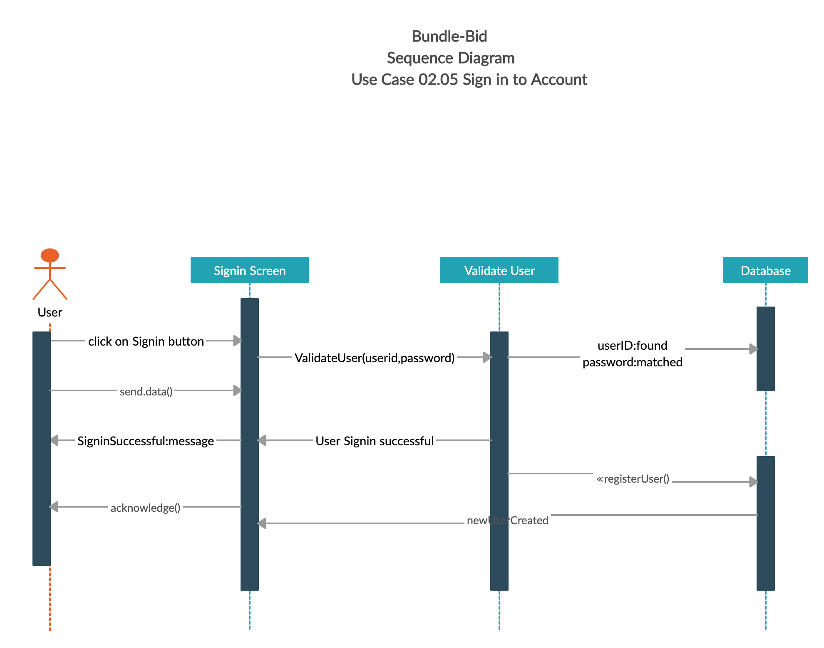
Bundle-Bid Sequence Diagram
Use Case 02.05 Sign in to Account

